Slide 1
Scheduling Disciplines
Do you even schedule?

Slide 2
Scheduling disciplines -- An introduction
There are many complex scheduling algorithms, and it is still an actively researched discipline, here we provide an introduction to some of them:
First in, First out (FIFO)
Earliest Deadline First
Shortest Remaining Time (Shortest Execution Time)
Fixed Priority Preemptive Scheduling
Round Robin Scheduling

Slide 3
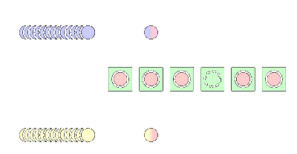
First in, First out (FIFO)
AKA First Come, First Served (FCFS)
Queues processes in the order they become ready
Processes run until completion before moving onto the next

Slide 4
First in, First out (FIFO)
Context switching only occurs after a process finishes
No reorganization of the process queue occurs
Scheduling overhead is minimal
Long processes can hold the CPU leading to
Low throughput
High wait time
High turn around time
No prioritization occurs
The system has trouble meeting deadlines

Slide 5
Earliest Deadline First (EDF)
Dynamic scheduling algorithm used in Real-time systems
Once a task, t₁, completes the ready queue is searched for the process with the closest deadline
EDF is optimal on preemptive uniprocessors
If a collection of independent tasks can be scheduled by any algorithm in a way that ensures all the jobs complete on time, the EDF algorithm will find one such a scheduling
Compared to rate-monotonic scheduling (fixed priority), EDF can guarantee all deadlines in a system at higher loading

Slide 6
Shortest Execution (Remaining) Time
The scheduler arranges processes with the least estimated processing time remaining to execute next in the queue
If a short process arrives during another process execution, the currently running process may be interrupted (preempted)
This creates additional overhead for context switching
Designed for maximum throughput
Response time increases as computational requirements increase
Overall wait time is less than that of FIFO
No attention is given to deadlines

Slide 7
Fixed Priority Preemptive Scheduling
Fixed priority rank is assigned to each process
Utilizes a priority queue to organize processes
Overhead is not minimal, but is not as dynamic as other algorithms
Waiting time and response time depend on priority of the processes
Deadlines can be met by giving processes with deadlines higher priority
Requires more input from the programmer to determine priority

Slide 8
Round Robin Scheduling
Assigns fixed time unit per process and cycles through them
Involves extensive overhead
Balanced throughput between FIFO and shortest execution time
Good average response time
Wait time is dependent on the number of processes not process length
Deadlines are rarely met

Slide 9
Round Robin Scheduling
Assigns time slices to each process in equal portions
In a circular order cycles through all processes that are currently executing
Ignores priority
Round robin is simple and easy to implement as well as starvation-free

